Slide 1
CSS342 Data Structures, Algorithms, and Discrete Mathematics (I)

Slide 2
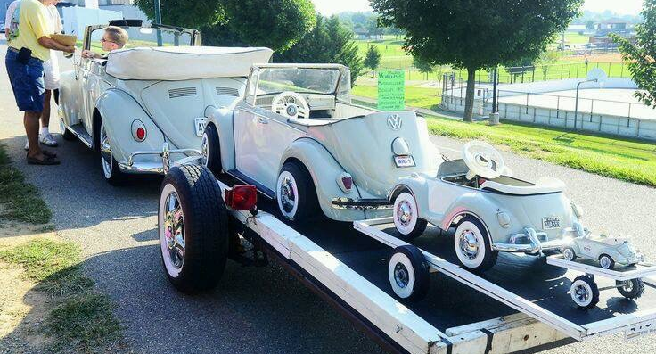
Recursion

Slide 3

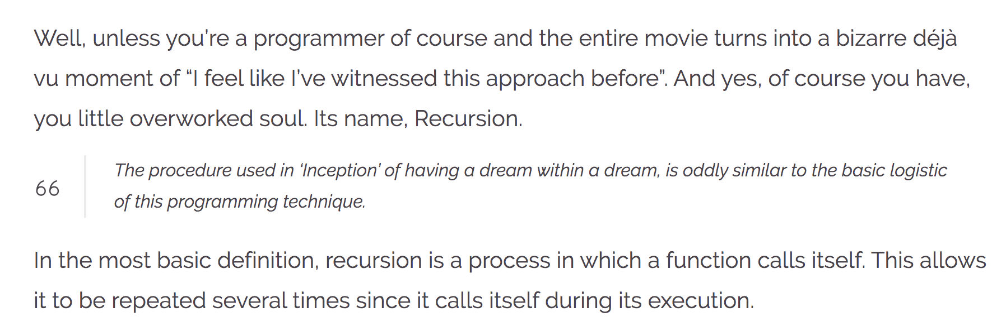
Recursion
https://wewrite.taleas.io/2018/11/14/why-inception-reminds-us-of-recursion/

Slide 4
Recursion

Slide 5
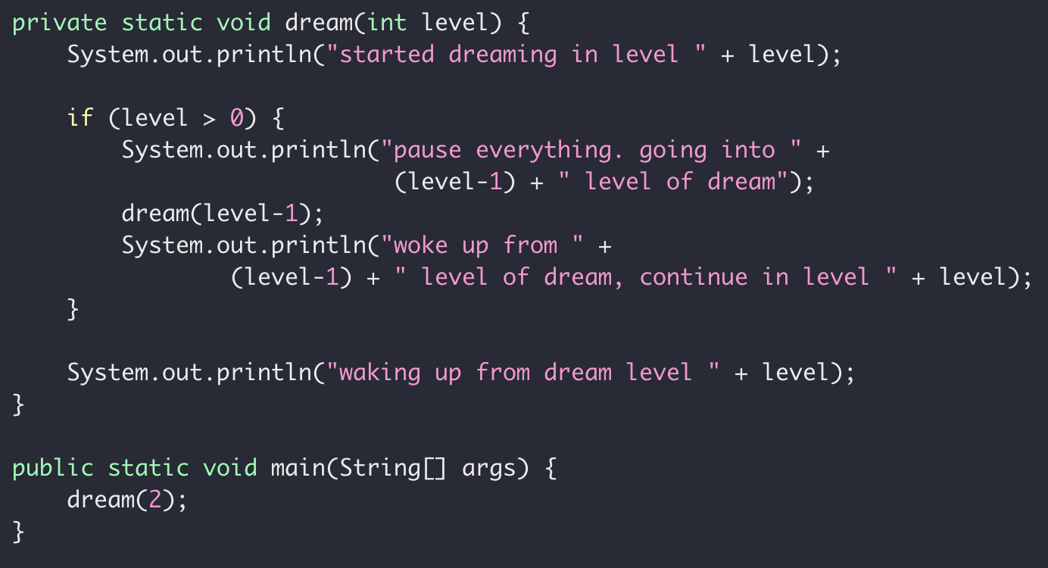
Dream in Recursion

Slide 6
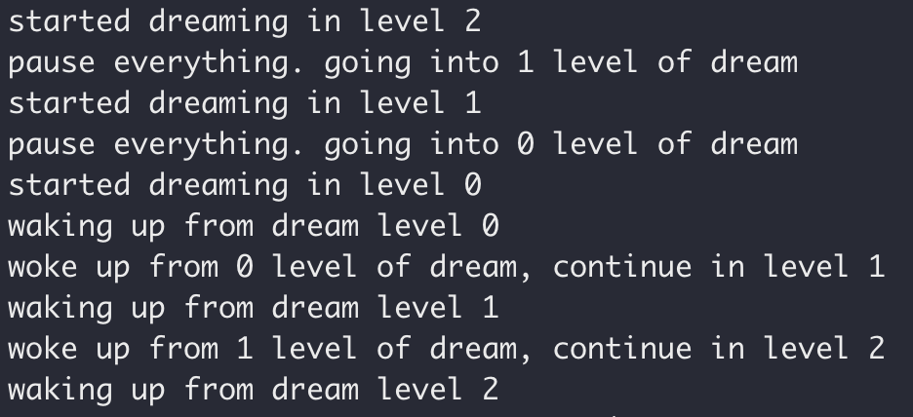
Dream in Recursion

Slide 7
Dream in Dream
Level 2
Level 0
Level 0
Time

Slide 8
Dream in Recursion

Slide 9
Dream in Recursion

Slide 10
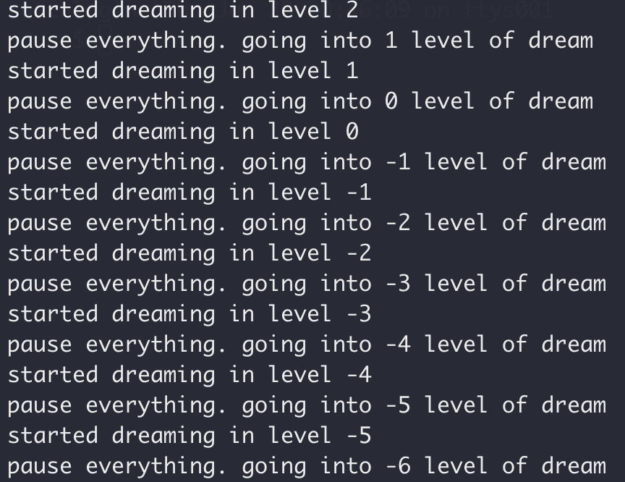
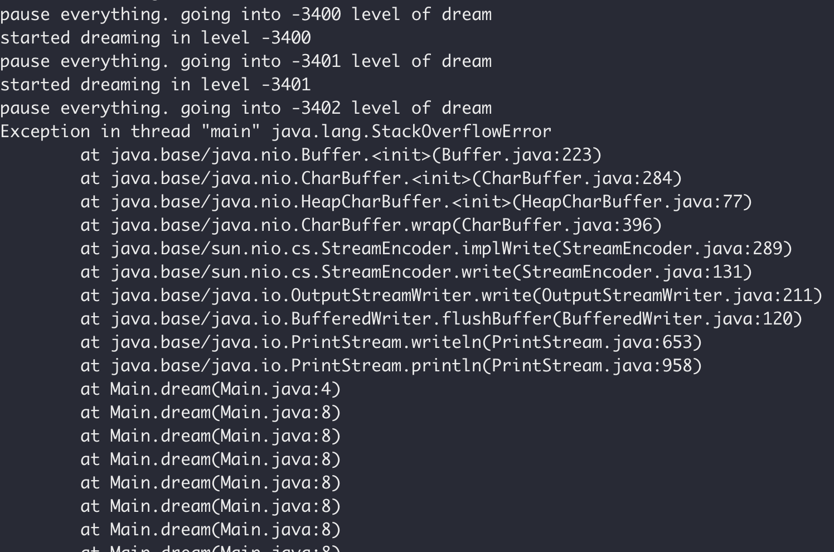
Dream in Recursion

Slide 11
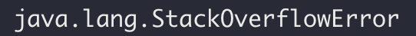
Dream in Recursion

Slide 12
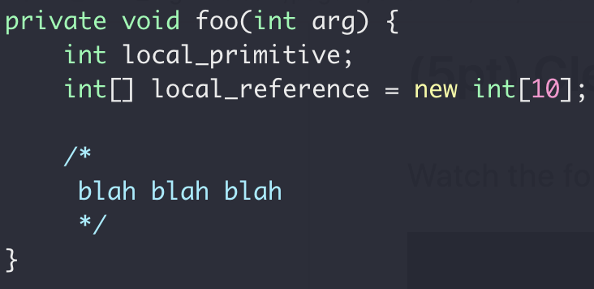
Function Call Stack
Heap
Int[10]
Stack
local_primitive
local_reference
Memory

Slide 13
Memory Map
Virtual Memory

Slide 14
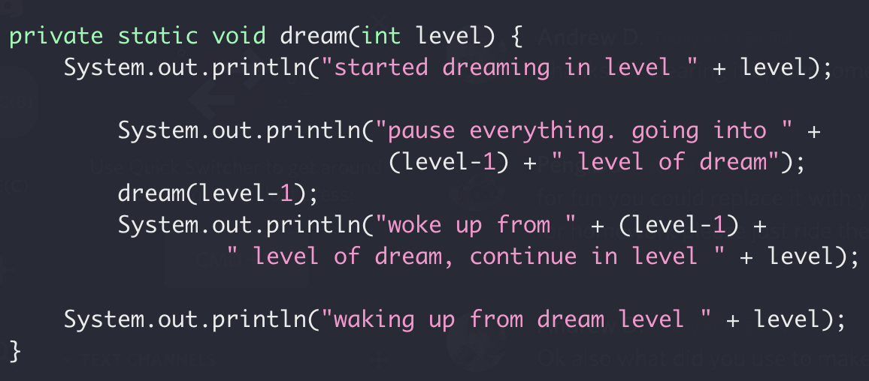
Function Call Stack
Heap
dream(2)
dream(1)
Locals for dream(0)
Return address of dream(1)
Locals for dream(1)
Stack
Return address of dream(2)
Locals for dream(2)
dream(0)
Return address of main()
Memory
More on function call
Stack buffer overflow attack
Notes:
http://www.pythontutor.com/visualize.html#mode=display

Slide 15
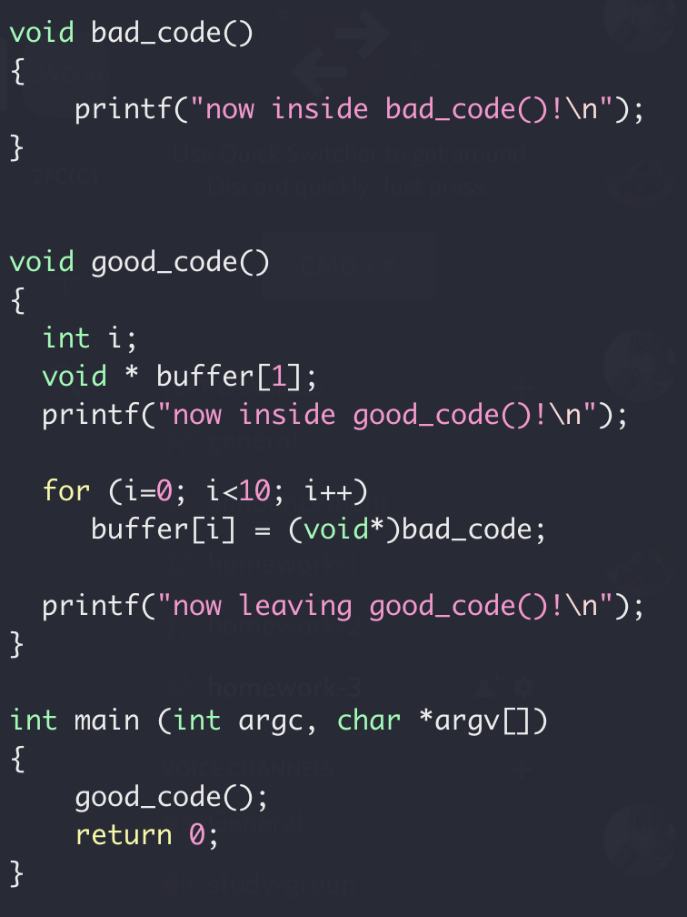
Function Call Stack
Locals for dream(1)
Stack
Return address of dream(2)
Locals for dream(2)
Return address of main()
Memory

Slide 16
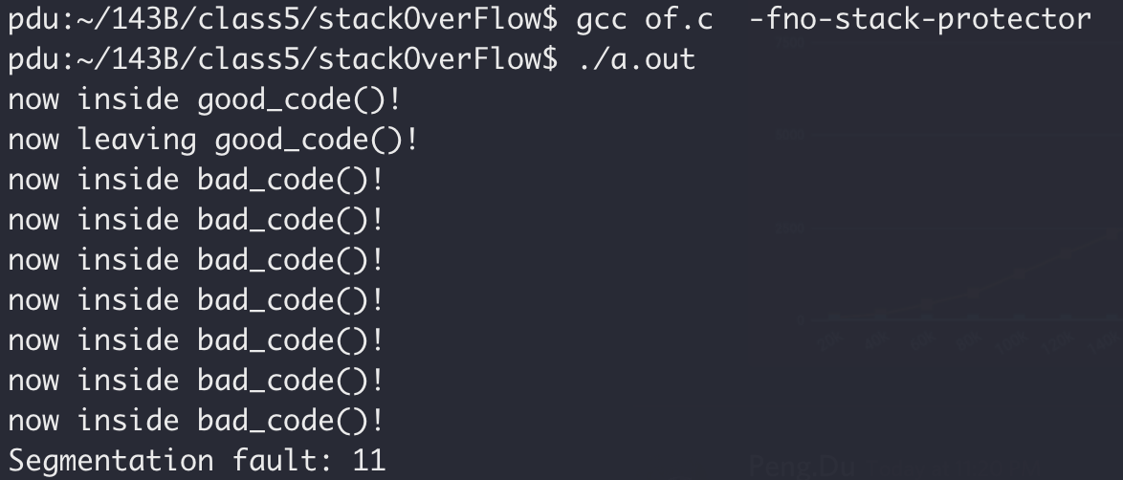
Function Call Stack
Stack smashing

Slide 17
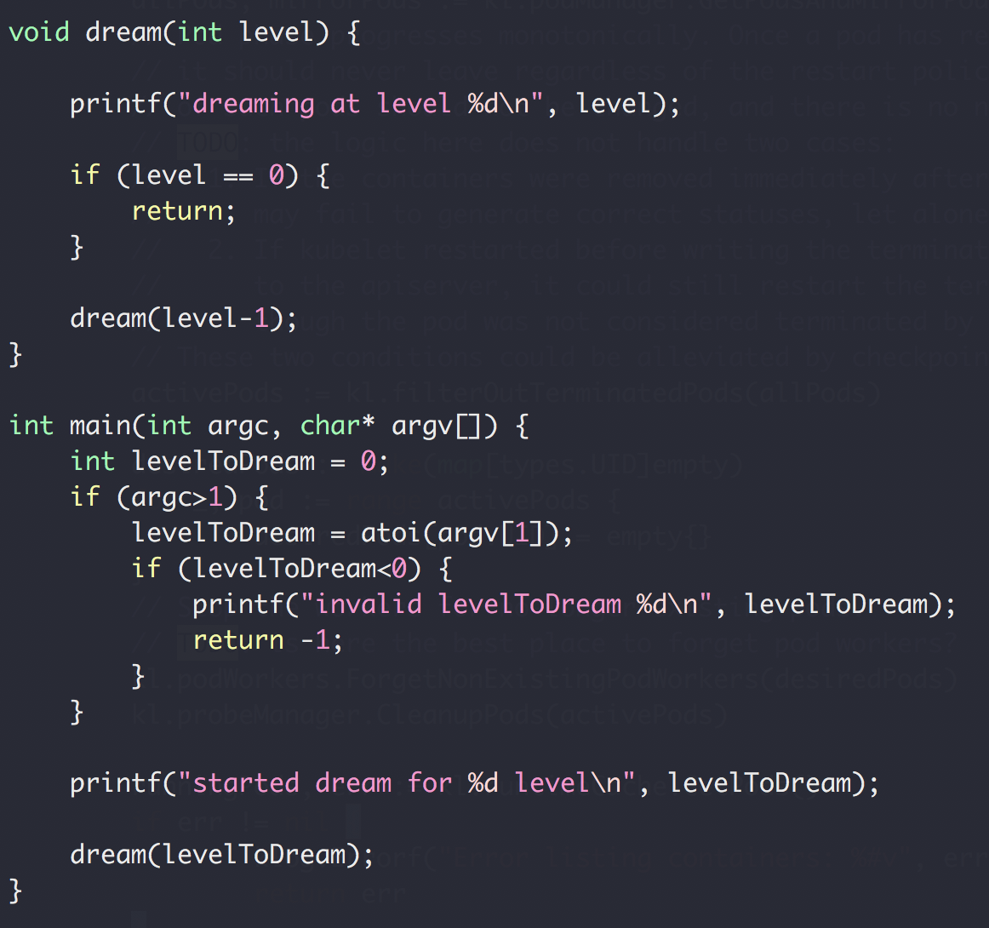
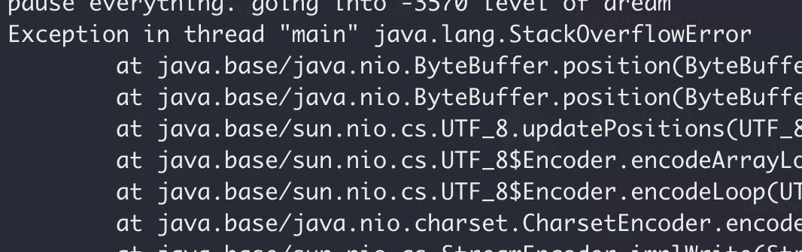
Function Call Stack
Heap
dream(N-4)
Return address of dream(N-3)
dream(N-3)
Return address of dream(N-2)
dream(N-2)
Return address of dream(N-1)
Stack
dream(N-1)
Return address of main()
main()
Memory

Slide 18
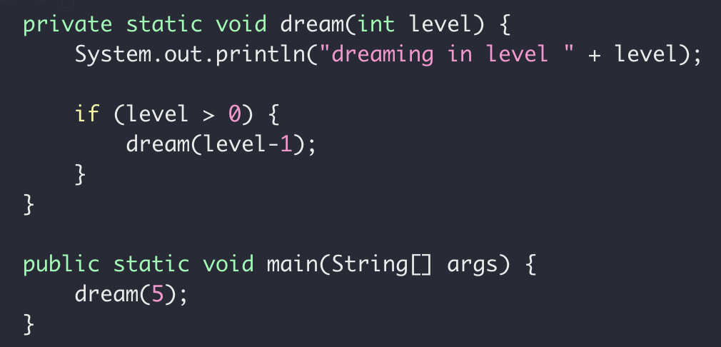
Recursion (and backtracking)
Recursion
Function Calling itself with different
Stop the recursion when the subproblem is ”small enough” and can be solved directly

Slide 19
Recursion (and backtracking)
Recursion
Split a problem in a smaller subproblem of the same kind
Call self for each subproblem
Stop the recursion when the subproblem is ”small enough” and can be solved directly

Slide 20
Recursion (and backtracking)
Recursion
Split a problem in a smaller subproblem of the same kind
Call self for each subproblem
Stop the recursion when the subproblem is ”small enough” and can be solved directly

Slide 21
Recursion (and backtracking)
How to find the largest apple
In box 0 to 5
0
1
2
3
4
5
Largest apple:
1
1
0

Slide 22
Recursion (and backtracking)
How to find the largest apple
In box 0 to 5 (noted as [0,5])
Get the first apple from [0,5]
Find the largest apple from [1,5]
compare it with apple 0
0
1
2
3
4
5

Slide 23
Recursion (and backtracking)
How to find the largest apple
In box 1 to 5
Get the first apple from [1,5]
Find the largest apple from 2-5
compare it with apple 1
0
1
2
3
4
5

Slide 24
Recursion (and backtracking)
How to find the largest apple
In box 2 to 5
Get the first apple from [2,5]
Find the largest apple from 3-5
compare it with apple 2
0
1
2
3
4
5

Slide 25
Recursion (and backtracking)
How to find the largest apple
In box 1 to 5
Get the first apple from [3,5]
Find the largest apple from 3-5
compare it with apple 3
0
1
2
3
4
5

Slide 26
Recursion (and backtracking)
How to find the largest apple
In box 1 to 5
Get the first apple from [4,5]
Find the largest apple from 4-5
compare it with apple 4
0
1
2
3
4
5

Slide 27
Recursion (and backtracking)
How to find the largest apple
In box 1 to 5
Only 1 apple is left, it’s the largest comparing to itself
0
1
2
3
4
5

Slide 28
Recursion (and backtracking)
How to find the largest apple
In box 1 to 5
Get the first apple from [4,5]
Find the largest apple from 4-5
compare it with apple 4
0
1
2
3
4
5

Slide 29
Recursion (and backtracking)
How to find the largest apple
In box 1 to 5
Get the first apple from [4,5]
Find the largest apple from 4-5
compare it with apple 4
0
1
2
3
4
5

Slide 30
Recursion (and backtracking)
How to find the largest apple
In box 1 to 5
Get the first apple from [3,5]
Find the largest apple from 3-5
compare it with apple 3
0
1
2
3
4
5

Slide 31
Recursion (and backtracking)
How to find the largest apple
In box 1 to 5
Get the first apple from [3,5]
Find the largest apple from 3-5
compare it with apple 3
0
1
2
3
4
5

Slide 32
Recursion (and backtracking)
How to find the largest apple
In box 2 to 5
Get the first apple from [2,5]
Find the largest apple from 3-5
compare it with apple 2
0
1
2
3
4
5

Slide 33
Recursion (and backtracking)
How to find the largest apple
In box 1 to 5
Get the first apple from [1,5]
Find the largest apple from 2-5
compare it with apple 1
0
1
2
3
4
5

Slide 34
Recursion (and backtracking)
How to find the largest apple
In box 1 to 5
Get the first apple from [1,5]
Find the largest apple from 2-5
compare it with apple 1
0
1
2
3
4
5

Slide 35
Recursion (and backtracking)
How to find the largest apple
In box 1 to 5
Get the first apple from [1,5]
Find the largest apple from 2-5
compare it with apple 1
0
1
2
3
4
5

Slide 36
Recursion (and backtracking)
How to find the largest apple
In box 0 to 5 (noted as [0,5])
Get the first apple from [0,5]
Find the largest apple from [1,5]
compare it with apple 0
0
1
2
3
4
5

Slide 37
Recursion (and backtracking)
How to find the largest apple
In box 0 to 5 (noted as [0,5])
Get the first apple from [0,5]
Find the largest apple from [1,5]
compare it with apple 0
0
1
2
3
4
5

Slide 38
A similar question
Find the largest number in an array
Array not sorted
interger
0
1
2
3
4
5

Slide 39
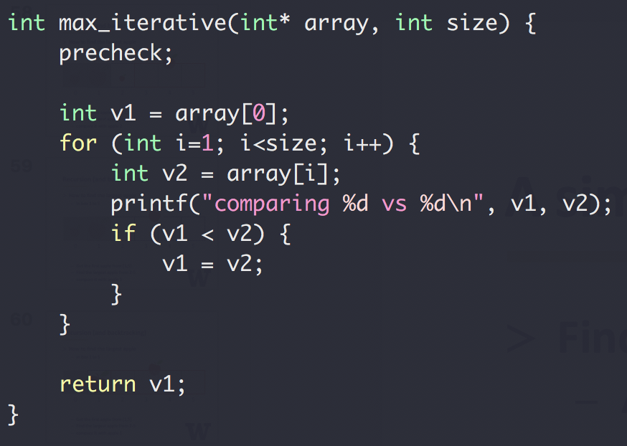
A similar question
Find the largest number in an array
Array not sorted
Integer
Method 1
Iterative

Slide 40
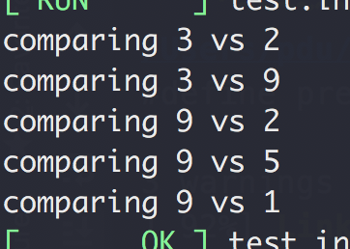
A similar question
Find the largest number in an array
Array not sorted
Integer
Method 1
Iterative
Input: [3,2,9,2,5,1]

Slide 41
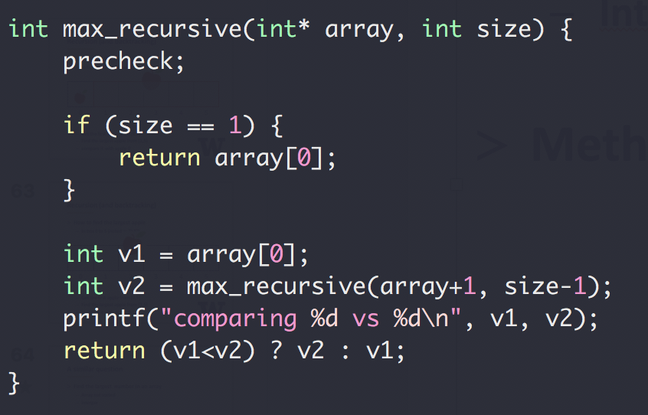
A similar question
Find the largest number in an array
Array not sorted
Integer
Method 2
Recursive

Slide 42
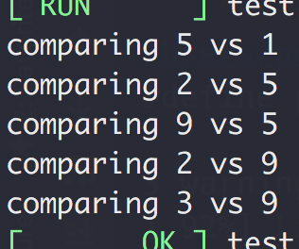
A similar question
Find the largest number in an array
Array not sorted
Integer
Method 1
Recursive
Input: [3,2,9,2,5,1]

Slide 43
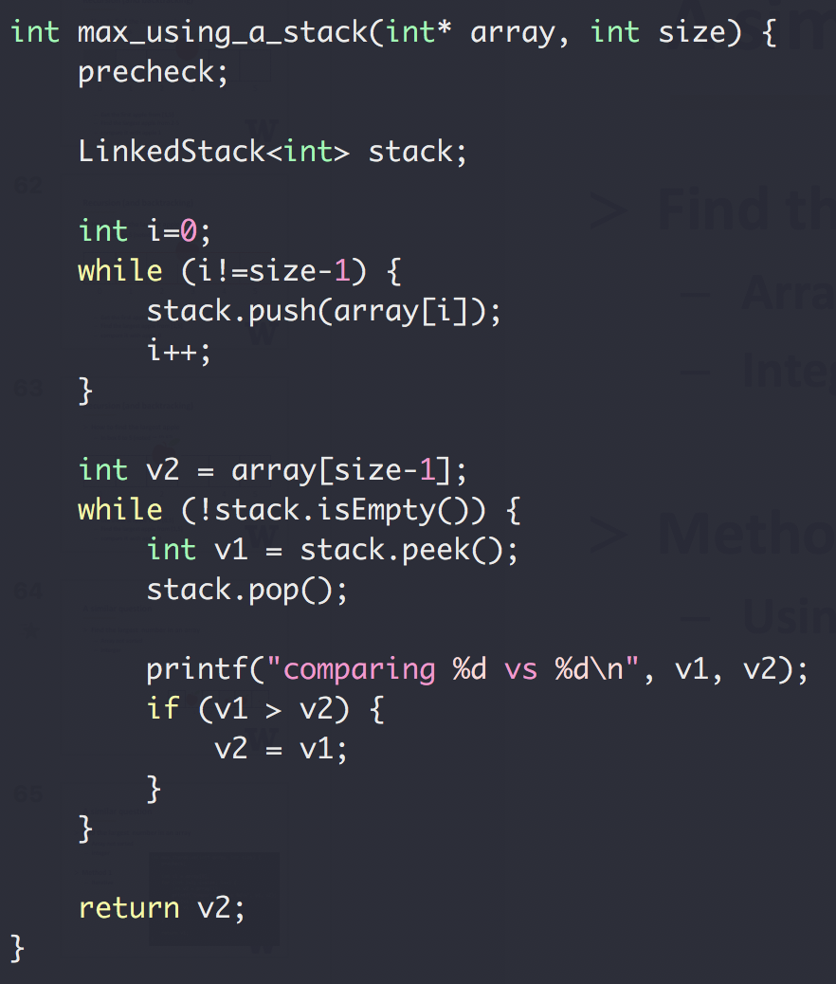
A similar question
Find the largest number in
an array
Array not sorted
Integer
Method 3
Using a stack

Slide 44
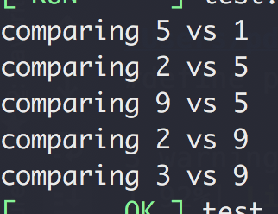
A similar question
Find the largest number in
an array
Array not sorted
Integer
Method 3
Using a stack
Input: [3,2,9,2,5,1]

Slide 45
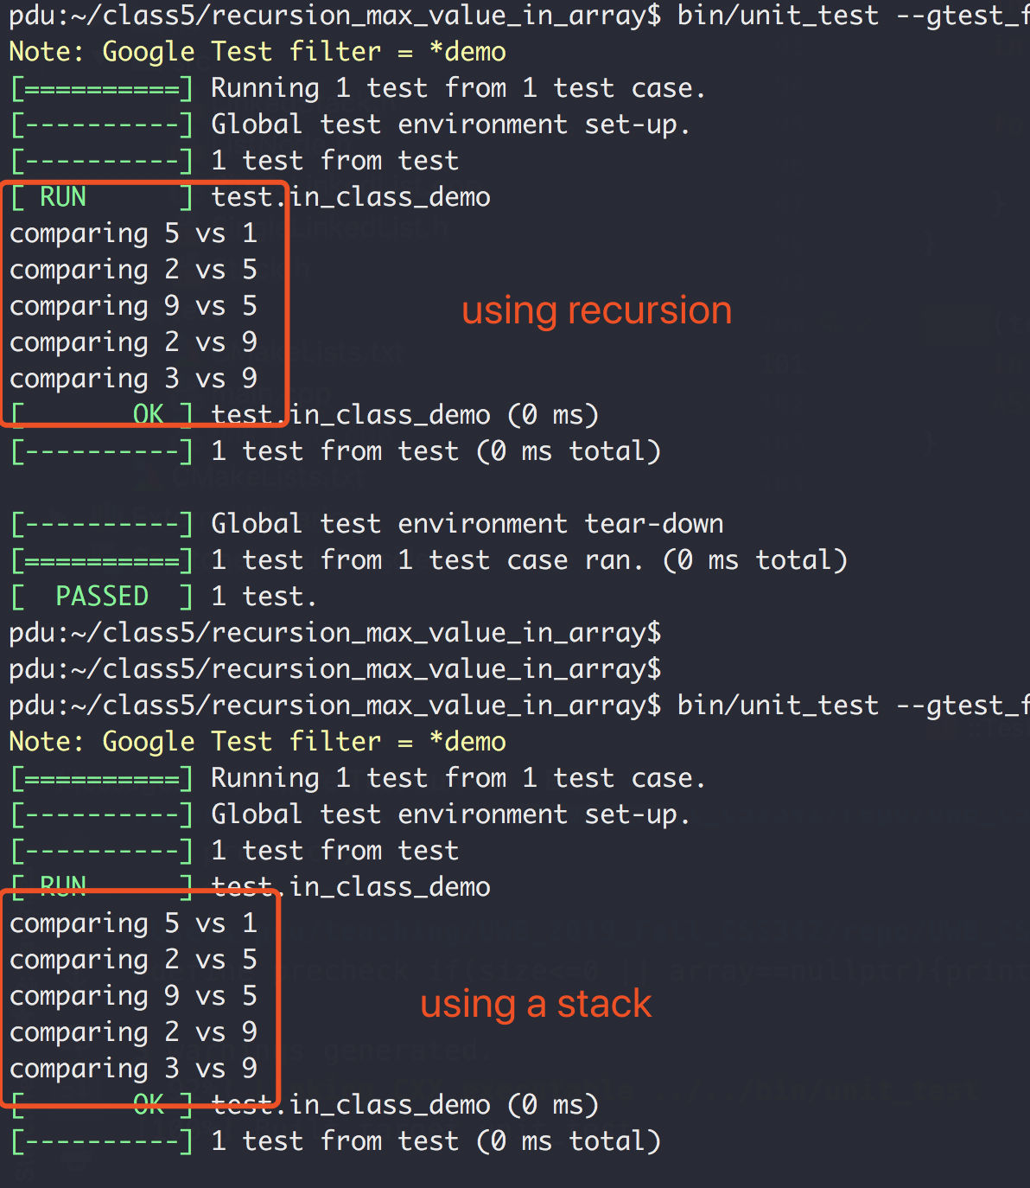
Recursion vs Stack

Slide 46
Recursion
Binary Search
Linear Search (target 12)
5 3 1 9 8 7 12 2 4
5 3 1 8 7 9 2 4 12
O(N) Can we do better?
Worse case we have to iterate N element

Slide 47
Binary Search
“Who checked that bug in?!!”
Source control svn, git, etc
1
2
3
4
5
6
7
8
9
10
Mike
Peng
Ethan

Slide 48

Binary Search
“Who checked that bug in?!!”
Source control svn, git, etc
Found a bug in version 10
No bug in version 1
?
?
?
?
?
?
?
?
1
2
3
4
5
6
7
8
9
10

Slide 49
Binary Search
Source control svn, git, etc
“Who checked that bug in?!!”
Found a bug in version 10
No bug in version 1
?
?
?
?
?
?
?
?
1
2
3
4
5
6
7
8
9
10

Slide 50
Binary Search
Source control svn, git, etc
“Who checked that bug in?!!”
Found a bug in version 10
No bug in version 1
?
?
?
?
?
?
?
?
1
2
3
4
5
6
7
8
9
10

Slide 51
Binary Search
Source control svn, git, etc
“Who checked that bug in?!!”
Found a bug in version 10
No bug in version 1
?
?
?
?
?
1
2
3
4
5
6
7
8
9
10
Bug introduced, found with 3 checks

Slide 52
Binary Search
Binary Search (target 12)
1 2 3 4 5 7 8 9 12
1 2 3 4 5 7 8 9 12
1 2 3 4 5 7 8 9 12
1 2 3 4 5 7 8 9 12
1 2 3 4 5 7 8 9 12
O(logN) both average and worst case

Slide 53
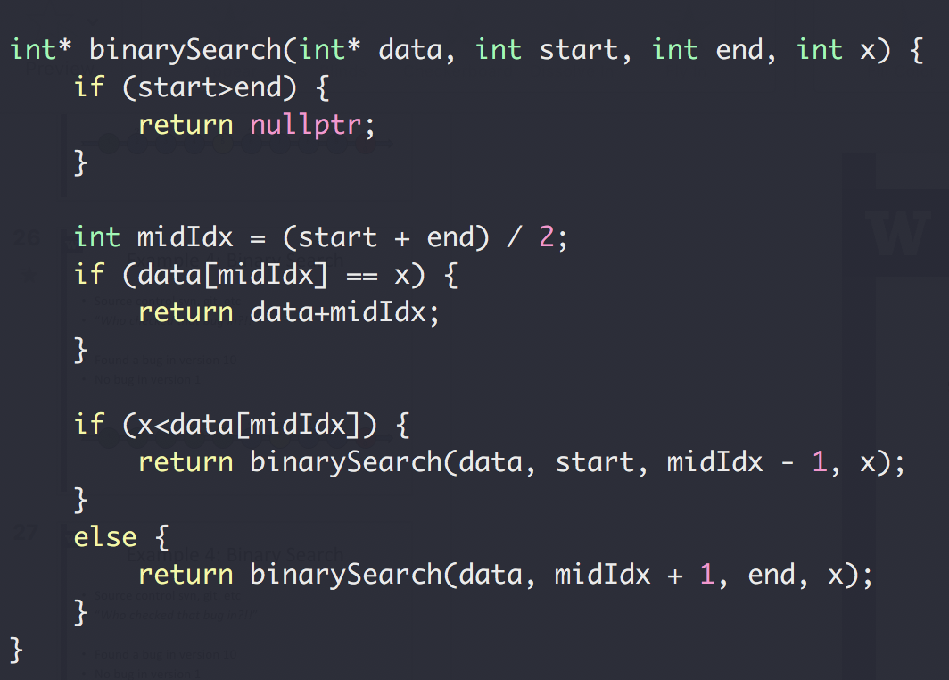
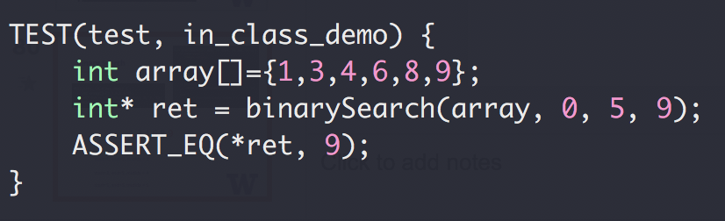
Binary Search

Slide 54
Binary Search
1,3,4,6,8,9
start=0, end=5, midIdx = 2
start=3, end=5, midIdx = 4
start=5, end=5, midIdx = 5

Slide 55
Binary Search
Up to 2³¹-1 for 32-bit signed int
What could go wrong?
The Java programming language library had this bug for 20+ years

Slide 56
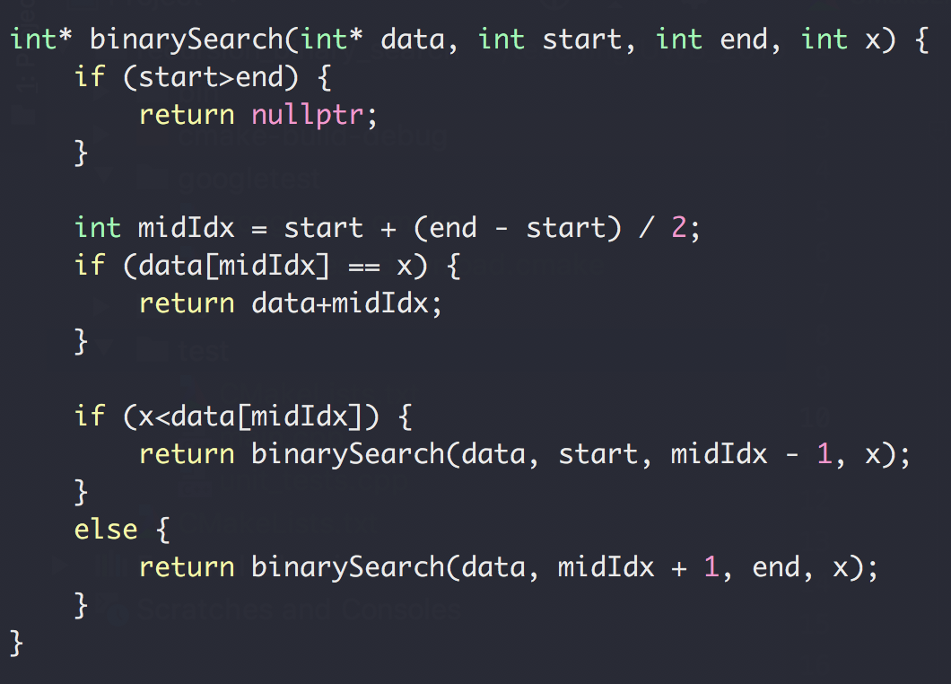
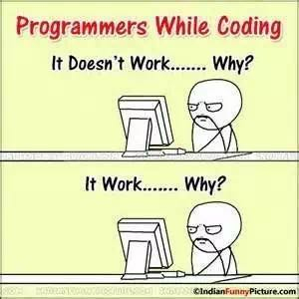
Binary Search

Slide 57
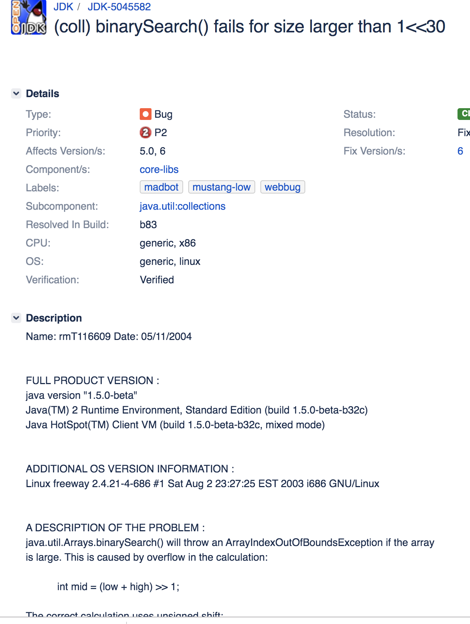
Binary Search
https://bugs.openjdk.java.net/browse/JDK-5045582

